Slide 1
Understanding Abstraction & Virtualization in Cloud Computing
by Samrat Sarkar

Slide 2
Abstraction & Virtualization
By means of Virtualization:
  the shared pool of resources are made available to the consumers
  allocation of the resources will be in an on-demand basis
  scalability factor guaranteed
  billing will be on the basis of usage
  multi-tenancy is enabled
Virtualization provides a means to manage resources efficiently.

Slide 3
Virtualization
Here are some of the types of Virtualization:
  Access: Access requests for cloud services can be made regardless of the location
  Application: Multiple instances of application are available in cloud and on a conditional basis the requests are directed to a particular application instance.
  CPU: Physical computers can be partitioned into a set of virtual machines with each machine being assigned a workload. Also load balancing may come into picture for the implementation of virtualization.
  Storage : Data is stored across several storage devices and often replicated for the sake of redundancy.

Slide 4
Virtualization
Now, to enable these characteristics, resources are required to be flexible, and highly configurable. These features conform to one or more of the following mobility patterns and enable flexibility:
  P2V: Physical to Virtual
  V2V: Virtual to Virtual
  V2P: Virtual to Physical
  P2P: Physical to Physical
  D2C: Datacenter to Cloud

Slide 5
Virtualization
C2C: Cloud to Cloud
C2D: Cloud to Datacenter
D2D: Datacenter to Datacenter
We will have a discussion on some of these mobility patterns.

Slide 6
Virtualization: Mobility Patterns
Physical To Virtual (P2V)
Physical to virtual (P2V) is the process of converting and migrating a physical computer image into a virtual machine (VM). It allows a physical machine to transform into a VM with the same state, stored data, applications and required system configuration and resources. Physical to virtual is also known as physical to virtual migration (P2V migration).
P2V is performed through purpose-built conversion and migration software or a composite solution.

Slide 7
Virtualization: Mobility Patterns
P2V tools save the physical machine's state and data as a VM snapshot or image instance. The VM manager or hypervisor tool allocates the required resources (including computing, memory, storage and networking) to the VM. The VM snapshot created from the physical machine is then reinstalled by the hypervisor on the allocated storage space.
P2V is commonly used in server consolidation and virtualization processes, where one or more physical servers are converted to run as virtual server on a single physical server.

Slide 8
Virtualization: Mobility Patterns
Virtual To Virtual (V2V)
Virtual to virtual (V2V) is a process of copying, migrating or replicating a virtual machine (VM) image, data or disk partition to another VM. It facilitates the migration of data or a machine instance between VMs and/or virtualization environments.
The V2V process is implemented and managed through a virtual machine manager (VMM) or virtualization hypervisor. V2V works when the complete VM image data is copied and transferred to another host machine, which may be a VM or physical computer/server.

Slide 9
Virtualization: Mobility Patterns
Similarly, each newly created and hosted VM instance may be swapped between different backend hosts.
V2V is also used to create VM and VM data backups for disaster recovery and other types of restoration needs.

Slide 10
Virtualization: Mobility Patterns
Virtual To Physical (V2P)
Virtual to physical (V2P) is the process of converting or porting a virtual machine (VM) onto and/or as a standard physical machine. V2P allows a VM to transform into a physical machine without losing its state, data and overall operations. Virtual to physical is also known as virtual to physical migration (V2P migration).
V2P is performed by a third-party tool external to the VM hypervisor and follows a systematic approach for successful migration. This includes verifying the hardware capacity and compatibility with a VM’s current configuration

Slide 11
Virtualization: Mobility Patterns
Required V2P tools include an operating system (OS) specific utility, which is used to create a VM image; an image transfer tool and native device drivers for the target physical machine. The OS tool that creates the OS image also facilitates the VM hardware setting configuration in line with the destination machine. The VM image/snapshot is copied exactly and configured by the same software and device drivers installed to complete the V2P migration process.

Slide 12
Virtualization: Mobility Patterns
Cloud To Cloud (C2C)
If you’re already in the cloud but are looking to make a change due to cost, performance or another business-critical reason, then you have to go for cloud to cloud migration. C2C migration is a delicate process that requires a very detailed execution plan to ensure your mission-critical functions never skip a beat and your end users’ service remains uninterrupted.

Slide 13
Virtualization: Mobility Patterns
Before performing a C2C migration here are some of the best practices to keep in mind:
  Cloud Provider Evaluation
    The first, and the most likely important factor to C2C, is determining who your new cloud provider will be. Beyond the standard questions about pricing and reliability, make sure you evaluate the following:
      Flexibility: Cloud computing is not a one-size-fits-all proposition. You’ll want to ensure your new cloud provider has the flexibility and know-how to evaluate your specific business needs and craft a solution that is tailor-made to meet them.

Slide 14
Virtualization: Mobility Patterns
      Security: These days, there are few factors more important than security. IT personnel are focused on preventing and detecting cyber attacks at all costs. Be sure to ask your cloud provider about their security protocols and auditing processes. Ensuring security is a full-time job that calls for constant monitoring, adjustment and maintenance. You need a provider that takes security as seriously as you do.
Planning
  The pre-migration portion of your C2C migration plan is critical. You’ll need to work with your cloud service provider to determine the type of migration, overall timeline and the lowest traffic window for end-users in which to enact the migration. Next are options to consider in your plan:

Slide 15
Virtualization: Mobility Patterns
      New Cloud Environment: With this approach, the cloud provider creates an entirely new cloud environment for customer applications. Once the cloud environment is constructed to the customer’s liking, the old cloud environment is replaced in favor of the new environment. This option is particularly attractive to companies that are looking to make major changes to the way their cloud is configured.
      Shutdown and Copy Virtual Machines (VMs): In this situation the cloud provider and customer strategically choose a period of time that has low traffic (such as a weekend or late night/early morning) to shut down the existing VMs, copy the cloud environment as is and reinstate the environment within the new provider’s VMs.

Slide 16
Virtualization: Mobility Patterns
      Flip and Switch: This option is similar to the previous one, but instead of copying VMs after they have been shut down, the cloud provider copies the live VMs to its environment for an instantaneous “flip and switch.”
    Another crucial portion of the planning phase is determining your monitoring strategy. You’ll want a well thought out strategy in place, so that once the migration is complete the monitoring process can begin immediately.

Slide 17
Virtualization
Indeed, the virtualization is regarded as the linchpin behind some of the key attributes of Cloud Computing:
  Service-based: A service based architecture is where clients are abstracted from service providers through service interfaces.
  Scalable and Elastic: Services may be modified to affect capacity and performance on demand.
  Shared services: Resourced are pooled in order to create greater efficiencies.
  Metered usage: Services are billed on a usage basis.
  Internet delivery: The services provided by cloud computing are based on internet protocols and formats.

Slide 18
Load Balancing & Virtualization
One of the main characteristic feature of Cloud Computing is that the network access to a service is virtualized. Regardless of the location you try to access the service you will be redirected to the available resources. The technology that is used to distribute service requests to resources is regarded as Load Balancing. The concept of load balancing can be implemented in hardware as well as in software.

Slide 19
Load Balancing & Virtualization
Load balancing is an optimization technique in a sense that it can be used to increase utilization & throughput, lower latency, reduce response time, and avoid system overload. The concept of load balancing can be applied to the following network resources:
  Network interfaces & services such as DNS, FTP, and HTTP
  Connections through intelligent switches
  Processing through computer system assignment

Slide 20
Load Balancing & Virtualization
  Storage resources
  Access to application instances
Without load balancing the cloud computing would be very difficult to manage. Load balancing provides necessary redundancy to make an intrinsically unreliable system reliable through managed redirection. And it also provides fault tolerance when coupled with a failover mechanism. Different mechanisms are available to implement load balancing.

Slide 21
Load Balancing & Virtualization
The simplest of all mechanisms is where the load balancer listens to a network port for service requests. When a request from a client arrives, the load balancer uses a scheduling algorithm to decide where the request is to be sent. Typical scheduling algorithms that are of use today:
    Round robin
    Weighted round robin
    Fastest response time
    Least connections
    Weighted least connections

Slide 22
Load Balancing & Virtualization
A session ticket is issued by the load balancer so that subsequent related traffic from the client that is part of that session can be properly enrouted to the same resource. Without this session record or persistence, a load balancer would not be able correctly transfer a request from one resource to another one in the event of a fault in a resource rendering it as inactive. Persistence can be enforced using session data stored in a database and replicated across multiple load balancers.

Slide 23
Load Balancing & Virtualization
Other methods may use the client’s browser to store a client side cookie or through the use of a rewrite engine that modifies the url. Of all these methods, a session cookie stored on the client side has the least amount of overhead for a load balancer because it allows the load balancer an independent selection of resources. The algorithm may be based on a simple round robin scheme where the next system in a list of systems gets the request.

Slide 24
Advanced Load Balancing
The more advanced load balancers are workload managers. In order to assign task to each resource they determine the following factors:
  The current utilization of the resources in their pool
  The response time
  The work queue length
  Connection latency and capacity

Slide 25
Advanced Load Balancing
Available features in load balancers are:
  Polling resources for their health
  The ability to bring standby servers online known as priority activation
  Workload weighting based on a resource’s capacity (asymmetric loading)
  HTTP traffic compression
  TCP offload and buffering
  Security and authentication
  Packet shaping using content filtering & priority queuing

Slide 26
Advanced Load Balancing
An Application Delivery Controller (ADC) is a combination of load balancer and application server. It is actually a server placed between a firewall or router and a pool of servers providing different web services. The ADC is assigned a virtual IP address which it maps to the pool of servers based on application-specific criterion. The ADC is also a device that works in both network & application layer.

Slide 27
Advanced Load Balancing
An ADC is regarded as an advanced load balancer as it not only contains all the discussed features of a load balancer but it also conditions content in order to lower the workload of the web servers. Services provided by an ADC are:
  Data compression
  Content caching
  Server health monitoring
  Security
  SSL offload
  Advanced routing based on current conditions

Slide 28
Advanced Load Balancing
An ADC is considered as an application accelerator, as because, one can find ADC’s that are tuned to accelerate ASP.NET or AJAX applications.
An architectural layer containing ADCs is depicted as an Application Delivery Network (ADN) and is considered to provide WAN optimization services. Every now and then, an ADN is comprised of a pair of redundant ADCs. The purpose of an ADN is to distribute content to resources based on application specific criteria. ADN provide a caching mechanism to reduce traffic, traffic prioritization and optimization. Most of the ADC vendors offer commercial ADN solutions.

Slide 29
The Google Cloud
According to Alexa (http://www.alexa.com/topsites) (a website tracking firm), Google is single most heavily visited site on the Internet. Google has made tremendous amount of investment in its infrastructure and possesses the largest cloud in use today. The estimated facts regarding Google is that, it runs over a million servers worldwide, processes a billion search requests, and generates 20 petabytes of data each day. Google believes that its infrastructure, system response & low latency are key factors to the company’s success.

Slide 30
The Google Cloud
Google has many datacenters around the world and it never allows datacenter tours to journalists neither even discloses where its datacenters are located. As per Rich Miller of DataCenterKnowledge.com, March,2008, Google had at least 12 major installations in the US and many more around the world. Google supports over 30 country specific versions of the Google index, and each localization is supported by one or more datacenters.

Slide 31
The Google Cloud
Based on current locations and the company’s statements, Google’s datacenters are sited based on the following factors:
  Availability of cheap and if possible, renewable energy
  The relative locations of other Google datacenters such that the site provides the lowest latency response between sites
  Location of nearby Internet hubs and peering sites
  A source of cooling power

Slide 32
The Google Cloud
  The ability to purchase a large area of land surrounding the site
  Tax concessions from municipalities that lower Google’s overhead
Google maintains a pool of hundreds of IP addresses all of which eventually resolve to its Mountain View, California headquarters. When you initiate a Google search, your query is sent to a DNS server which then queries Google’s DNS servers.

Slide 33
The Google Cloud
The Google DNS server examine the pool of addresses to determine which addresses are geographically closest to the query origin and uses a round robin policy to assign an IP address to that request. The request usually goes to the nearest datacenter, and there to a cluster of Google servers. A Google cluster may contain thousands of servers. Servers are arranged in racks with 40-80 servers & one switch per rack. Each switch is connected to a core gigabit switch. Google servers run a customized version of Linux with applications of several types.

Slide 34
The Google Cloud
When the query request arrives at its destination, a Google cluster is sent to a load balancer, which forwards that request to a Squid proxy server and Web cache daemon. The Squid server checks its cache and if it find a match to the query, the match is returned and the query has been satisfied. Whereas if there is no match in the cache, the query is sent to an individual Google Web server based on current web server utilizations. It is the Google Web Servers that perform the query against the Google index and then format the result into an html page that is returned to the requester.

Slide 35
The Google Cloud
Google doesn’t use hardware virtualization. It performs server load balancing to distribute the processing load and to get high utilization rates. The workload management software transfers the workload from a failed server over to a redundant server, and the failed server is taken offline.

Slide 36
Understanding Hypervisors
Generally by dint of abstraction we create virtual systems out of physical systems.
Suppose you have a computer system with a given set of resources, you may take some portion of these resources to build a virtual machine. From the perspective of users or applications, a virtual machine has all the attributes and characteristic features of a physical system but is strictly a software that emulates a physical machine.

Slide 37
Understanding Hypervisors
A hardware virtual machine is also called a system virtual machine and will be possessing its very own or exclusive set of resources.
Some virtual machines are designed to run only a single application or process and are called process virtual machines.
A virtual machine may be a computer system running on a physical device but it may differ from that device in respect of the software it runs.

Slide 38
Understanding Hypervisors
As a result we may find virtual machine technology very useful for running old versions of operating systems, or in the case of cloud computing, creating virtual machine instances which can be assigned to a workload.
Virtual machines provide the ability of running multiple machine instances, each with their own OS.
So, in respect of cloud computing, the above mentioned features enable the Virtual Machine Monitors to do a few things that are mentioned in the next slide.

Slide 39
Understanding Hypervisors
  Manage provisioning of applications
  Provide for machine instance cloning & replication
  Allow for graceful system failover
The disadvantage of VM technologies is that having resources indirectly addressed means there is some level of overhead.
The low level program that is required to provide system resource access to virtual machines, is called the Virtual Machine Monitor or Hypervisor.

Slide 40
Hypervisor Types
The hypervisor running on top of the bare hardware of the computer system is referred to as Type 1 Hypervisor or Native Hypervisor.
Guest OS
Guest OS
Guest OS
Hypervisor
System Hardware
Type 1 Hypervisor

Slide 41
Hypervisor Types
Examples of Type 1 Hypervisors are LynxSecure, RTS Hypervisor, Oracle VM, Sun xVM Server, Virtual LogixVLX, Vmware ESX & ESXi, and Wind River Vxworks.
The operating system loaded into a virtual machine is referred to as the guest operating system, and there is no constraint on running the same guest on multiple VMs on a physical system. Type 1 hypervisors do not have any host OS because they are installed on a bare system.

Slide 42
Hypervisor Types
Some hypervisors are installed over an operating system and are referred to as Type 2 Hypervisors or Hosted VMs.
Guest OS
Guest OS
Guest OS
Hypervisor
Host Operating System
System Hardware
Type 2 Hypervisor

Slide 43
Hypervisor Types
Examples of Type 2 Hypervisors are Containers, KVM, Microsoft Hyper V, Parallels Desktop for Mac, Wind River Simics, VMWare Fusion, Virtual Server 2005 R2, Xen, Windows Virtual PC, and Vmware Workstation 6.0.
Type 2 hypervisors are installed over a host OS; as in case of Microsoft Hyper V, that OS would be Windows Server. The Xen hypervisor runs on top of Linux host OS. Xen is used by Amazon Web Services to provide Amazon Machine Instances(AMI).

Slide 44
Hypervisor Types
On a Type 2 VM, a software interface is created by the host operating system that emulates the devices with which a system would normally interact. This abstraction is meant to place many I/O operations outside the virtual environment which makes it both programmatically easier and more efficient to execute device I/O than it would be inside a virtual environment. This type of virtualization is sometimes referred to as paravirtualization and it is found in hypervisors such as Microsoft’s Hyper V and Xen. It is the host OS that is performing the I/O through a para-API. In the next section we discuss about the types of hardware virtualization techniques.

Slide 45
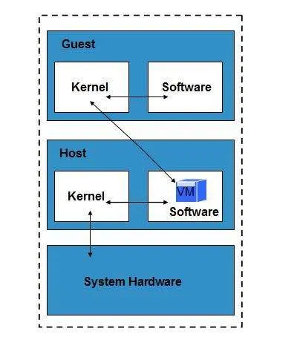
Hardware Virtualization: Emulation
In Emulation type of hardware virtualization, the virtual machine simulates hardware, so it can be independent of the underlying system hardware. A guest OS using emulation does not need to be modified under any circumstances.
Emulation

Slide 46
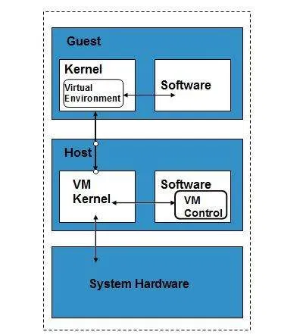
Hardware Virtualization: Paravirualization
Paravirtualization requires that the host OS provide a virtual machine interface for the guest OS and the guest access hardware through that host VM. An OS running as a guest on a paravirtualization system must be ported to work with the host interface.
Paravirtualization

Slide 47
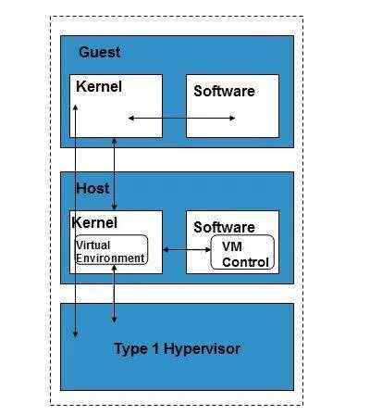
Hardware Virtualization: Full Virtualization
In a full virtualization scheme, the VM is installed as a Type 1 Hypervisor directly onto the hardware. All operating systems in full virtualization communicate directly with the hypervisor, so guest operating systems do not require any modifications. Guest operating systems in full virtualization systems are generally faster than the other virtualization schemes.
Full Virtualization

Slide 48
Virtual Machines
The Virtual Machine Interface(VMI) open standard proposed by VMware is an example of paravirtualization API and it ships as a default installation with many versions of the Linux OS.
A process virtual machine is instantiated when a command begins a process, the VM is created by an interpreter, the VM then executes the process, and finally when the execution is over, the VM exits the system and is destroyed. During its existence, the VM runs as a high level abstraction.

Slide 49
Virtual Machines
Applications that run inside application virtual machines are generally a bit slow, but these programs are very popular as because they
  offer portability
  offer rich programming languages
  come with many advanced features
  And allow platform independence for their programs
Although many cloud applications provide process virtual machine applications but they are not really suitable for building a high performing cloud network.

Slide 50
OS Virtualization
As in cloud technology, virtualization plays an important role to make things easy and being efficiently done, virtualization need to be done at the OS level also. With the technique of virtualized OS, nothing is required to be pre-installed or permanently loaded on the local storage device. Everything runs from the network using a kind of virtual disk. This virtual disk is actually a disk image file stored on a remote server, SAN (Storage Area Network) or NAS (Non-volatile Attached Storage). The client will be connected by the network to this virtual disk and will boot with the Operating System installed on the virtual disk. Sun Solaris and IBM AIX 6.1 supports operating system virtualization.

Slide 51
OS Virtualization
How does OS Virtualization work?
Components needed for using OS Virtualization in the infrastructure are given below:
The first component is the OS Virtualization server. This server is the centre point in the OS Virtualization infrastructure. The server manages the streaming of the information on the virtual disks for the client and also determines which client will be connected to which virtual disk (using a database, this information is stored). Also the server can host the storage for the virtual disk locally or the server is connected to the virtual disks via a SAN (Storage Area Network). In high availability environments there can be more OS Virtualization servers to create redundancy and load balancing. The server also ensures that the client will be unique within the infrastructure.

Slide 52
OS Virtualization
Secondly, there is a client which will contact the server to get connected to the virtual disk and ask for components stored on the virtual disk for running the operating system.
The available supporting components are database for storing the configuration and settings for the server, a streaming service for the virtual disk content, a (optional) TFTP service and a (also optional) PXE boot service for connecting the client to the OS Virtualization servers.

Slide 53
OS Virtualization
As it is already mentioned that the virtual disk contains an image of a physical disk from the system that will reflect to the configuration and the settings of those systems which will be using the virtual disk. When the virtual disk is created then that disk needs to be assigned to the client that will be using this disk for starting. The connection between the client and the disk is made through the administrative tool and saved within the database. When a client has an assigned disk, the machine can be started with the virtual disk using the following process as displayed in the Figure on the next slide:

Slide 54
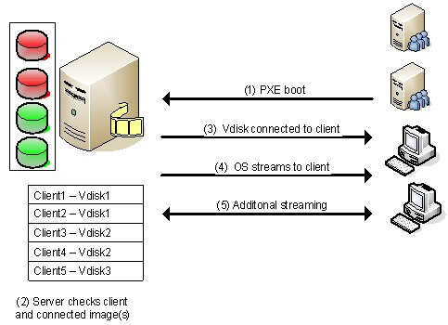
OS Virtualization

Slide 55
OS Virtualization
1) Connecting to the OS Virtualization server:
First we start the machine and set up the connection with the OS Virtualization server. Most of the products offer several possible methods to connect with the server. One of the most popular and used methods is using a PXE service, but also a boot strap is used a lot (because of the disadvantages of the PXE service). Each method initializes the network interface card (NIC), receiving a (DHCP-based) IP address and a connection to the server.

Slide 56
OS Virtualization
2) Connecting the Virtual Disk:
When the connection is established between the client and the server, the server will look into its database for checking whether the client is known or unknown and which virtual disk is assigned to the client. When more than one virtual disks are connected then a boot menu will be displayed on the client side. If only one disk is assigned, that disk will be connected to the client which is mentioned in step number 3.

Slide 57
OS Virtualization
3) VDisk connected to the client:
After the desired virtual disk is selected by the client, that virtual disk is connected through the OS Virtualization server. At the back-end, the OS Virtualization server makes sure that the client will be unique (for example computer name and identifier) within the infrastructure.

Slide 58
OS Virtualization
4) OS is "streamed" to the client:
As soon the disk is connected the server starts streaming the content of the virtual disk. The software knows which parts are necessary for starting the operating system smoothly, so that these parts are streamed first. The information streamed in the system should be stored somewhere (i.e. cached). Most products offer several ways to cache that information. For examples on the client hard disk or on the disk of the OS Virtualization server.

Slide 59
OS Virtualization
5) Additional Streaming:
After that the first part is streamed then the operating system will start to run as expected. Additional virtual disk data will be streamed when required for running or starting a function called by the user (for example starting an application available within the virtual disk).

Slide 60
Storage area network (SAN)
A storage area network or storage network is a computer network which provides access to consolidated, block-level data storage. SANs are primarily used to access storage devices, such as disk arrays and tape libraries from servers so that the devices appear to the operating system as direct-attached storage.

Slide 61
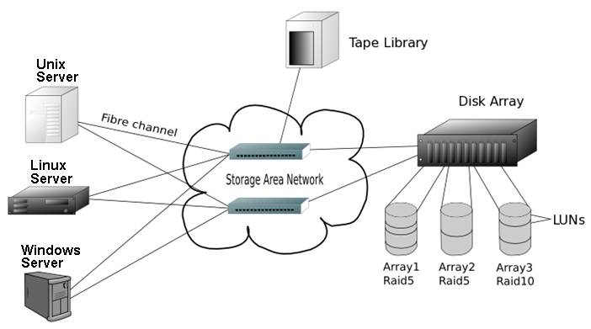
Storage area network (SAN)
Storage Area Network( SAN )

Slide 62
Preboot eXecution Environment (PXE)
The Preboot eXecution Environment (PXE) defines requirements for consistent, hardware-independent network-based machine booting and configuration. Formally, PXE specifies pre-boot protocol services that client NIC firmware must provide (DHCP, TFTP, UDP/IP), specifies boot firmware requirements, and defines a client-server protocol for obtaining a network boot program (NBP) which automates OS installation and configuration.

Slide 63
PXE Booting
Pre-Boot Execution Environment (PXE):
Derived from DHCP
Implemented in the NIC and BIOS
Used to load Operating System images onto a target computer
Requires NIC capable of PXE (e.g. Intel® 82574L Gigabit Ethernet Controller)

Slide 64
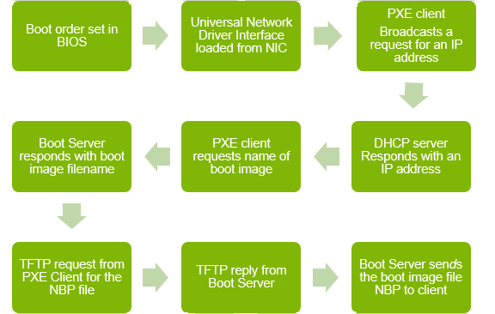
PXE Booting

Slide 65
PXE Booting
Image Description
Boot order set in BIOS
Universal Network Driver Interface loaded from NIC
PXE client broadcasts a request for an IP address
DHCP server responds with an IP address
PXE client requests name of boot image
Boot server responds with boot image filename
TFTP request from PXE client for the NBP file
TFTP reply from Boot Server
Boot Server sends the boot image file NBP to client

Slide 66
Trivial FTP( TFTP )
TFTP Server is used for simple file transfer (typically for boot-loading remote devices). Trivial File Transfer Protocol (TFTP) is a simple protocol for exchanging files between two TCP/IP machines. TFTP servers allow connections from a TFTP Client for sending and receiving files.

Slide 67
Vmware vSphere
VMware vSphere is a management infrastructure framework which virtualizes system, storage, and networking hardware to create cloud computing infrastructures. vSphere is the branding for a set of management tools and a set of products previously labeled VMware Infrastructure. vSphere provides a set of services that applications can use to access cloud resources.

Slide 68
Vmware vSphere
Services offered by vSphere include:
  Vmware vCompute: A service that aggregates servers into an assignable pool
  Vmware vStorage: A service that aggregates storage resources into an assignable pool
  Vmware vNetwork: A service that creates and manages virtual network interfaces
  Application Services: Such as High Availability & Fault Tolerance
  vCenter Server: A provisioning, management, and monitoring console for VMware cloud infrastructure.

Slide 69
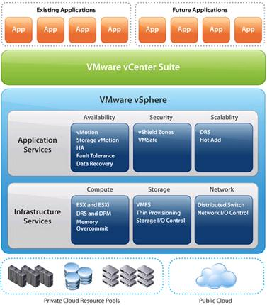
Vmware vSphere

Slide 70
Vmware vSphere
The vSphere cloud is a purely infrastructure thing. The virtualization layer abstracts processing, memory, and storage. It uses the VMware ESX or ESXi virtualization server. ESX is a type 1 Hypervisor and installs over bare metal using a Linux kernel to boot and installs the VMkernel hypervisor. When the system is rebooted, the VMkernel loads first, and then the Linux kernel becomes the first guest OS to run as a virtual machine on the system and contains the service console.

Slide 71
Understanding Machine Imaging
A mechanism commonly used in Cloud Computing is for storing the state of a system using a system image. A system image makes a copy or a clone of the entire computer system inside a single container such as a file. The system imaging program is used to make this image and can be used later to restore a system image. Some imaging programs can take snapshots of systems, and most of them allow users to view the files contained in the image and do partial restores.

Slide 72
Understanding Machine Imaging
This machine imaging mechanism is used in Cloud Computing to provide
  System portability
  Instantiation of applications
  Provision and deployment of systems in the cloud
An appropriate example of machine imaging and its use in cloud computing architectures is the Amazon Machine Images(AMI) used by AWS to store copies of a virtual machine.

Slide 73
Amazon Machine images(AMI)
AMI is a key feature of Amazon’s Elastic Compute Cloud(EC2) and is a file system image that contains
  An operating system
  All appropriate device drivers
  Any application and state information related to the working virtual machine
When a user subscribes to AWS he/she can choose to use one of its hundreds of available AMIs or to create a custom system and capture its image to an AMI.

Slide 74
Amazon Machine images(AMI)
An AMI may be available for
  Public use under a free distribution license
  Pay-per-use with OS such as Windows
  Shared use when shared by an EC2 user with other users having access privileges
The AMI file system is not a standard bit-for-bit image of a system. AMI omits the kernel image and stores a pointer to a particular kernel that is part of the AWS kernel library.

Slide 75
Amazon Machine images(AMI)
Among the choices in AMI archive are
  Red Hat Linux
  Ubuntu
  MS Windows
  Solaris and others
In AMI, files are compressed and encrypted, and an XML file is written that describes the AMI archive. AMIs are usually stored in Amazon S3(Simple Storage System) buckets as a set of 10MB chunks.

Slide 76
Machine Imaging
Machine images are systems expected to run on virtualization platforms and are thereby often called as “Virtual Appliances”. As an example, AWS EC2 runs on Xen hypervisor.
Virtual appliance means to differentiate the software image from an operating virtual machine. The system image contains the OS and applications that create an environment. Most VAs are used to run a single application and are configurable from a webpage.
They are of major significance in the field of cloud computing.

Slide 77
Open Virtualization Format (OVF)
Open Virtualization Format (OVF) is an open source standard for packaging and distributing software applications for virtual machines.
An OVF package contains multiple files in a single directory. The directory always contains an Extensible Markup Language (XML) file called the OVF descriptor with the name, hardware requirements, and references to other files in the package.

Slide 78
Open Virtualization Format (OVF)
In addition, the OVF package typically contains a network description, a list of virtual hardware, virtual drives, certificate files, information about the operating system (OS) and in some cases, a human-readable description of every information item.
The OVF standard is one of several standards and initiatives supported by the Distributed Management Task Force (DMTF).

Slide 79
Open Virtualization Format (OVF)
VMware, a company that provides virtualization software for x86 computers, offers a widely-used OVF package. Numerous other vendors including IBM, Microsoft, JumpBox, VirtualBox, XenServer, AbiCloud, OpenNode Cloud, SUSE Studio, Morfeo Claudia, and OpenStack use OVF in their virtualization products.

Slide 80
Distributed Management Task Force(DMTF)
DMTF (formerly known as the Distributed Management Task Force) creates open manageability standards spanning diverse emerging and traditional IT infrastructures including cloud, virtualization, network, servers and storage. Member companies and alliance partners worldwide collaborate on standards to improve the interoperable management of information technologies.

Slide 81
Distributed Management Task Force(DMTF)
Nationally and internationally recognized by ANSI and ISO, DMTF standards enable a more integrated and cost-effective approach to management through interoperable solutions. Simultaneous development of Open Source and Open Standards is made possible by DMTF, which has the support, tools, and infrastructure for efficient development and collaboration.
DMTF is a 501(c)(6) standards organization led by a diverse board of directors from Broadcom Inc., Cisco, Dell Technologies, Hewlett Packard Enterprise, Hitachi Ltd., Intel Corporation, Lenovo, and NetApp.

Slide 82
Porting Applications
From the outset of Cloud Computing, application portability has been quite an issue. Applications designed for Cloud Computing have the ability to run on virtual systems and they perform well within expectation as long as they are running for the host vendor, but problems may ensue if attempt is made to transfer them from the host cloud vendor to some other vendor. Cloud computing being a relatively new area of technology, the major vendors have technologies that so far do not interoperate with one another.

Slide 83
Porting Applications
The Simple Cloud API
If an application is built on Microsoft Azure platform, porting that application to AWS or GoogleApps may be difficult. In an effort to create an interoperability standard, Zend Technologies has started an open source initiative to create a common application programming interface that will allow applications to be portable. The initiative is called The Simple API for Cloud Application Services.

Slide 84
Porting Applications
The Simple Cloud API
Among the founding supporters are IBM, Microsoft, Nirvanix, RackSpace, and GoGrid.
Simple Cloud API has as its goal a set of common interfaces for:
  File Storage Services
  Document Storage Services
  Simple Queue Services
Uptill now this has been proved to be effective for porting applications written in PHP.

Slide 85
Queue Services
Queue services in cloud computing are the kinds of web services used for providing temporary storage for messages that are in transit between computers. Examples are, Amazon Simple Queue Services(SQS), Windows Azure Queue Storage, etc.

Slide 86
Problems Related to Porting Applications
Applications that run in datacenters are operating system and hardware platform specific. So moving an application from one platform to another is not as simple as moving a machine image from one system to another.
Applications are generally fastened with the OS when they run. For example, an application that runs on Windows, loads or uses Dynamically Linked Library (DLL) files while it runs.

Slide 87
Problems Related to Porting Applications
If some alteration are done in the contents of those DLL files, the application might well be in trouble. Also registry modifications occur at the time of the application installation which further enhances the porting complexity of the application. If someone works as a PaaS application developer, then he/she will be packaging a complete software stack that includes not only the application but the OS, the application logic and rules as well which effectively means vendor lock-in is guaranteed.

Slide 88
AppZero Virtual Application Appliance
One company which is working on the problem of cloud application portability other than the Simple Cloud API, is AppZero and its solution is called the Virtual Application Appliance. The AppZero solution creates a VAA as an architectural layer between the Windows or the Unix operating system and applications. This layer serves as the mediator for File I/O, memory I/O and application calls, and response to DLLs. The running application in AppZero does not change any registry entries or any of the files in the Windows server.

Slide 89
AppZero Virtual Application Appliance
VAA creates a container that encapsulates the application and all of the application’s dependencies within a set of files. It is essentially an application image for a specific OS. Dependencies include:
  DLL
  Service settings
  Necessary configuration files
  Registry entries
  Machine & network settings

Slide 90
AppZero Virtual Application Appliance
This container forms an installable server-side application stack that can be run after installation, but has no impact on the underlying OS. VAAs are created using AppZero Creator wizard, managed with AppZero Admin tool, and may be installed using AppZero Director, which creates a VAA runtime application.

Slide 91
Thanks a lot !!!

